Slide 1
OLAP Concepts Part 2
<OLAP Concepts 101 Series>
Anupama Putcha

Slide 2
Module Overview
On-Line Analytical Processing is a decision support software that allows the user to quickly analyze information that has been summarized into multidimensional views and hierarchies.
There are three main features of OLAP system :
Multidimensional Viewing – OLAP supports multidimensional model which consists of facts and dimensions also called as Star Schema.
Calculation Intensive Capabilities – Due to data is stored in facts and dimensions tables, it enables users to analyze data without much calculations.
Time Series analysis – Enables users to analyze data across time.
This Module will cover the details in three parts:
Part 1 – Importance of BI, DWH Architecture and different reporting types.
Part 2 – Data Access and Analysis, OLAP Introduction and Types

Slide 3
OLAP Objectives – Part Overview
Upon completion of this module you will be able to:
Understand What is Data Access and Analysis
See the limitation of traditional decision making tools.
Know the requirements of Data access tools.
See the various category of Data Access and Analysis.
Appreciate the importance of Data Access

Slide 4
OLAP Outline
Lesson 1 Data Access & Analysis
Lesson 2 OLAP Introduction
Lesson 3 OLAP Types

Slide 5
Data Access and Analysis

Slide 6
Importance
Facilitates easy and controlled access to authorized users
Provides helpful metadata to the users
Lowers operating costs
Encapsulates technical complexity like physical structure of the database from the users

Slide 7
Categories - 1
Different categories of Data Access ..
Reporting
On-Line Analytical Processing (OLAP)
Data Mining
Web Access
BI
Reporting
Delivery Focused
WEB ACCESS
OLAP
“Heavy
Analytics “
Analytic Focused
Data Mining

Slide 8
Categories - 2
Reporting
A category of data access solution in which the information is presented in the form of reports
Reporting tools are also referred as Query and reporting tools
OLAP
Defined as “Fast Analysis of Multidimensional Information” by the OLAP council
Used interchangeably with ‘Business Intelligence (BI)’
OLAP tools are synonymous with Multidimensional tools or applications

Slide 9
Data Access and Analysis - Categories
Data Mining
A process that uses a variety of statistical and artificial intelligence frameworks to discover patterns and relationships in data
Used to make valid predictions in data analysis problems where the exact sequence and nature of queries/questions to be written/asked against the data to make the prediction is not known and the number of variables involved in the analysis is too large to be intuitively handled by structured querying or OLAP tools
Web Access
A category of data access solutions in which information is viewed through a web browser

Slide 10
Users
Reporting Solution | OLAP Solution | Data Mining Solution | Web Services Solution
Operating personnel, Standard fixed format reports for power users | Analysts, Decision makers | Decision makers | Operating personnel, Analysts, Decision makers

Slide 11
Data Access & Analysis Tools
High Performance
Scalable
Ease of Use
Rich Reporting Features
Encapsulates technical complexity like physical structure of the database from the users
Facilitates easy and controlled access to authorized users
Provides helpful metadata to the users
Provides a variety of features for analyzing the data

Slide 12
Introduction to OLAP

Slide 13
OLAP – An Introduction
OLAP – On Line Analytical Processing
On Line – Emphasizes live access to data, not static reporting
Analytical Processing – Ad-hoc quires, drill-down, roll-up, reporting across various dimension
Category of technology that enables users to gain insight into their data in a fast, interactive and easy to use manner
OLAP provides the following 3 features
Multidimensional viewing Capabilities -Browsing and Navigation (Slice and dice)
Calculation Intensive Capabilities
Time Intelligence - Time Series analysis

Slide 14
Key Objects within OLAP
Key Objects within OLAP
Measures – represents factual data
Example: sales, cost, profit
Types of measures
Stored measures (Example: revenue, expense)
Calculated measures (Example: ratio, averages, profit)
Dimensions – identify and categorize data
Example: product, time, geography, customer
Key Components
Hierarchies – a logical grouping of data
Levels – position in hierarchy
Attributes – descriptive information about dimension

Slide 15
Distinction between OLTP and OLAP
 | OLTP System | OLAP System
Source of data | Operational data; OLTPs are the original source of the data | Consolidation data; OLAP data comes from the various OLTP databases
Purpose of data | To control and run fundamental business tasks | Decision support
What the data reveals | A snapshot of ongoing business processes | Multi-dimensional views of various kinds of business activities
Inserts and Updates | Short and fast inserts and updates initiated by end users | Periodic long-running batch jobs refresh the data
Queries | Relatively standardized and simple queries returning relatively few records | Often complex queries involving aggregations

Slide 16
Functional Requirements of OLAP
Rich dimensional structuring with hierarchical referencing
Efficient specification of dimensions and dimensional calculations
Separation of structures and representation
Flexibility
Sufficient speed to support ad hoc analysis
Multi-user support

Slide 17
OLAP Types

Slide 18

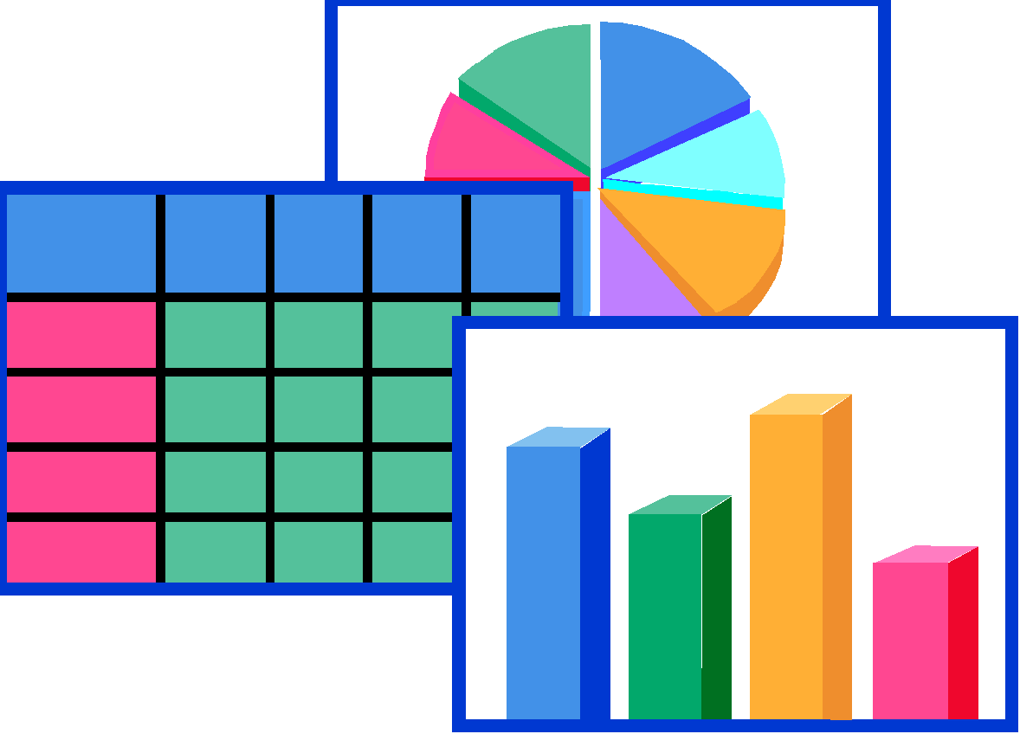


MOLAP – Multidimensional OLAP
Data is stored in multidimensional cubes
MDDB technology is proprietary.
Compilation intensive architecture.
Load involves series of aggregations across orthogonal dimensions
Good to access pre-aggregated data
MDDB Engine
MDDB Engine
Decision Support Client
Database Layer
Application Logic Layer
Presentation Layer

Slide 19





ROLAP
Support for large databases with good performance
Excellent platform portability
Good exploitation of hardware advances such as parallel processing
Codd rules however are not concerned about storage, but about functionality only
Data Warehouse
ROLAP Engine
Decision Support Client
Database Layer
Application Logic Layer
Presentation Layer
Notes:
‹#›
Hi, I am Anupama, and Today I will take you through the OLAP concepts Part II module.
The module covers the basics of Data Access and tools used for Data Access .
So let us begin our session with an overview of the same.
The Target Audience is:
Team Rainbow (TRB) associates assigned to DW-BI practice after completion of Induction training
Associates newly joined to DW-BI practice with out prior DWH implementation experience
© 2009 Wipro Ltd – Internal & Restricted
‹#›

Slide 20
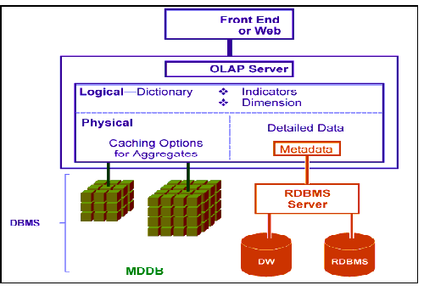
HOLAP - Hybrid OLAP
Hybrid approach seeks to provide best of both worlds - MOLAP and ROLAP
Create MDB structures for fast analytical needs
Create mappings to RDBMS for larger data volumes
The engine hides these mappings/ structures from the end user

Slide 21
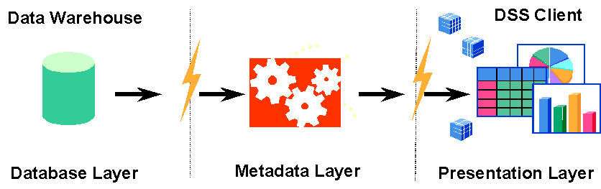
DOLAP
Desktop OLAP tools work by extracting RDBMS data into local (or server) MD cubes
User queries are limited to the predefined dimensions in the hypercube
Do not provide shared environment
Do not provide read/write capabilities
Low cost tools
Notes:
‹#›
© 2009 Wipro Ltd – Internal & Restricted
‹#›

Slide 22
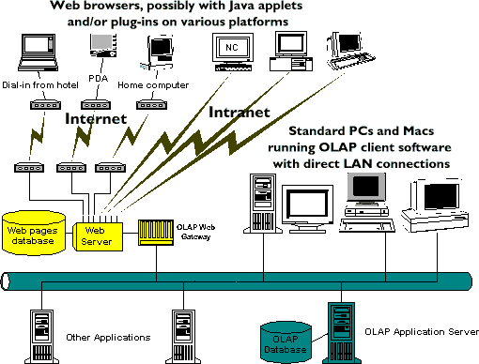
Web OLAP
Most OLAP products can now be deployed to Web browsers
Approaches used
Static Web publishing - The reports are generated in the form of HTML documents
Using a Web OLAP Server - Simple scripts allow users to perform basic manipulations like dimension rotations, drill downs and dimension member selections

Slide 23
Quiz

Slide 24
Question 1
1. An Operational Data Store is <fill in the blanks> collection of data in support of an organization's need for up-to-the-second, operational, integrated, collective information.“ Which one is the in-correct option ?
integrated
non-volatile
current-valued
detailed-only
Answer: B
Notes:
In Part I of OLAP Concepts we have understood limitations in traditional decision support system, significance and future of business intelligence, and hence let us understand one of the key aspects of DWH & BI Application i.e. Data Access and Analysis
Data Access typically refers to software and activities related to storing, retrieving, or acting on data housed in a database or other repository
Data Analysis has multiple facets and approaches, encompassing diverse techniques under a variety of names, in different business, science, and social science domains. In short data analysis is a process of gathering, modeling, and transforming data with the goal of highlighting useful information, suggesting conclusions, and supporting decision making
In this section we will explain
Importance of Data Access & Analysis
Various Categories of Data Access & Analysis
Information Consumers i.e. Users

Slide 25
Question 2
2. The process of data analysis includes:
Gathering, modeling, and transforming data.
highlighting useful information.
suggesting conclusions, support decision making
All of the above.
Answer: D

Slide 26
Question 3
3. Which are the different categories of data access techniques that are mainly Analytic Focused?
OLAP
Reporting
Data Mining
A and C
Answer: D

Slide 27
Question 4
4. Data Mining Solution is used mostly by:
Analysts
Power users
Decision makers
Operating personnel
Answer: C
Notes:
Data Access & Analysis Tools
High Performance – Enterprise’s today carry voluminous data, however data access tools are expected to provide instant desired results
Scalable – Business users are spread cross departments, business units that may be geographically distant apart and quite possibly speaking different languages, today’s data access & analysis tools are expected to be scalable enough to cover geo’s, languages, currency etc.
Ease of Use – intuitive, consistent interface to all functions of tool
Rich Reporting Features – Slicing and Dicing of Information, Drill-down’s, roll-up’s, drill-through
And the list is never ending
Like for instance
Short learning curve
Tight integration with central metadata repository
Scheduling of reports should be possible

Slide 28
Question 5
5. What are the key objects in OLAP ?
HOLAP and DOLAP
Measures and Dimensions
ROLAP and MOLAP
Slice and Dice
Answer: B
Notes:
‹#›
Data access layer categorized in various ways of accessing data resides in data warehouse.
Reporting can be done over the Web or in desktop based environment and may or may not be for business intelligence. Regular operational reporting can be happened just to do a end of the balance check of customer account and a reconciliation with prior day balance and the day’s transaction. This type of report may not provide any business intelligent to help in growth of organization
All OLAP analysis happens over the web because it needs multiple access in more flexible environment to analysis the performance of business. This type of analysis requires ad-hoc intelligences in the report to support. For an example, one Sales senior manager wants to understand the zone wise. Agent wise, insurance policy in last quarter against the sell of policy in the prior quarter. This type of analysis requires more flexibility to check the values against selected dimensions to understand the business
Data mining is a specialty analytical system where we finds for hidden trend or truth of data.
Web access – a common feature of business intelligence tool

Slide 29
Question 6
6. What are the different types of OLAP
ROLAP,HOLAP
ROLAP,HOLAP,OLAP
ROLAP,HOLAP,MOLAP and DOLAP
MOLAP,ROLAP
Answer: C

Slide 30
References

Slide 31
References
Publications
Courses
URL’s
Training Programs
For further reading, you can visit SAP
Library:
http://help.sap.com/saphelp_46c/helpdata/en/77/bff8ab4a2911d182b80000e829fbfe/frameset.htm>

Slide 32
Thank You
Anupama Putcha
Senior Software Engineer
anupama.putcha@wipro.com

